Slide 1
Визуализация данных
Лекции доступны онлайн по адресу
http://github.com/a-vodka/dv

Slide 2
Social Network Analysis (SNA) with Gephi
https://gephi.org

Slide 3
What is Social Network Analysis
Contribution of network analysis to online communities
Social Network Analysis with Gephi
What is Gephi
Gephi Interface
Using Gephi on facebook social network
Where we can also use Gephi

Slide 4
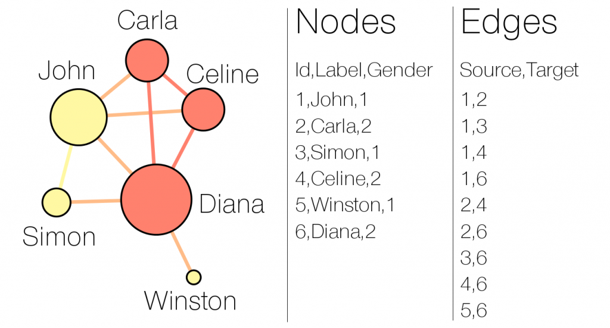
What is Social Network Analysis
Social network analysis (SNA) is a mathematical or computer science theory which consist to visualized and modeled the individuals of a network and the relationships between these individuals keep on through algorithms and statistics to glimpse a number information according to the user need.

Slide 5
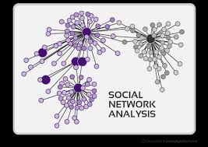
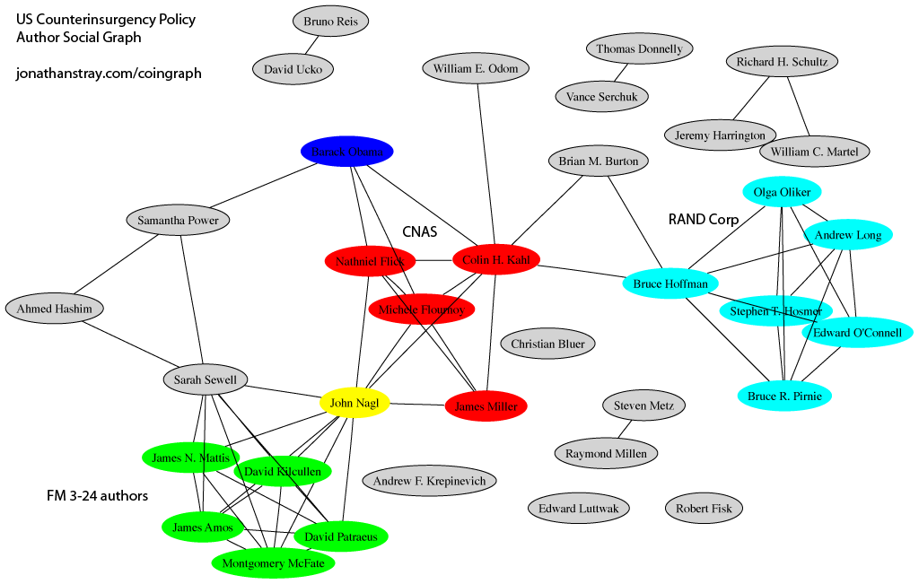
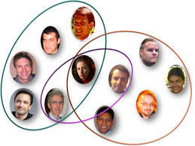
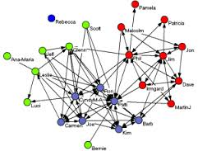
Examples of Social Network Analysis

Slide 6
Contribution of network analysis to online communities
Identify the group creators
Identify opinion leaders
Identify key accounts of a network
Identify information consumers in a network
Identify the main distributors of information in the network
Identify the different groups of people or concepts in a network
Follow the dissemination of a message
Determine the dominant genre of a network
Multimember ship identify an individual
Identify individuals keep having the most or the relationships in a network
Identify the network of an individual
Communities detections
...

Slide 7
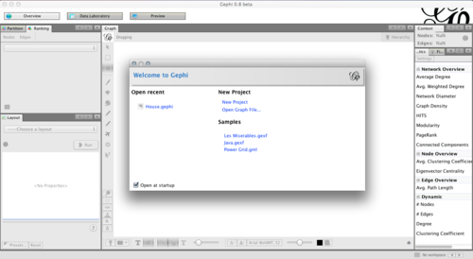
Social Network Analysis with Gephi
What is Gephi
Created in 2008 by a team of four software engineers; usable on Mac, Windows and Linux; Gephi is a software for viewing, analysis and data mining as graphs of any type.
The objective is to facilitate the analysis of data in the generation of hypotheses, intuitive discovery of patterns, isolation of singularities or detection of errors related to the capture of data.

Slide 8
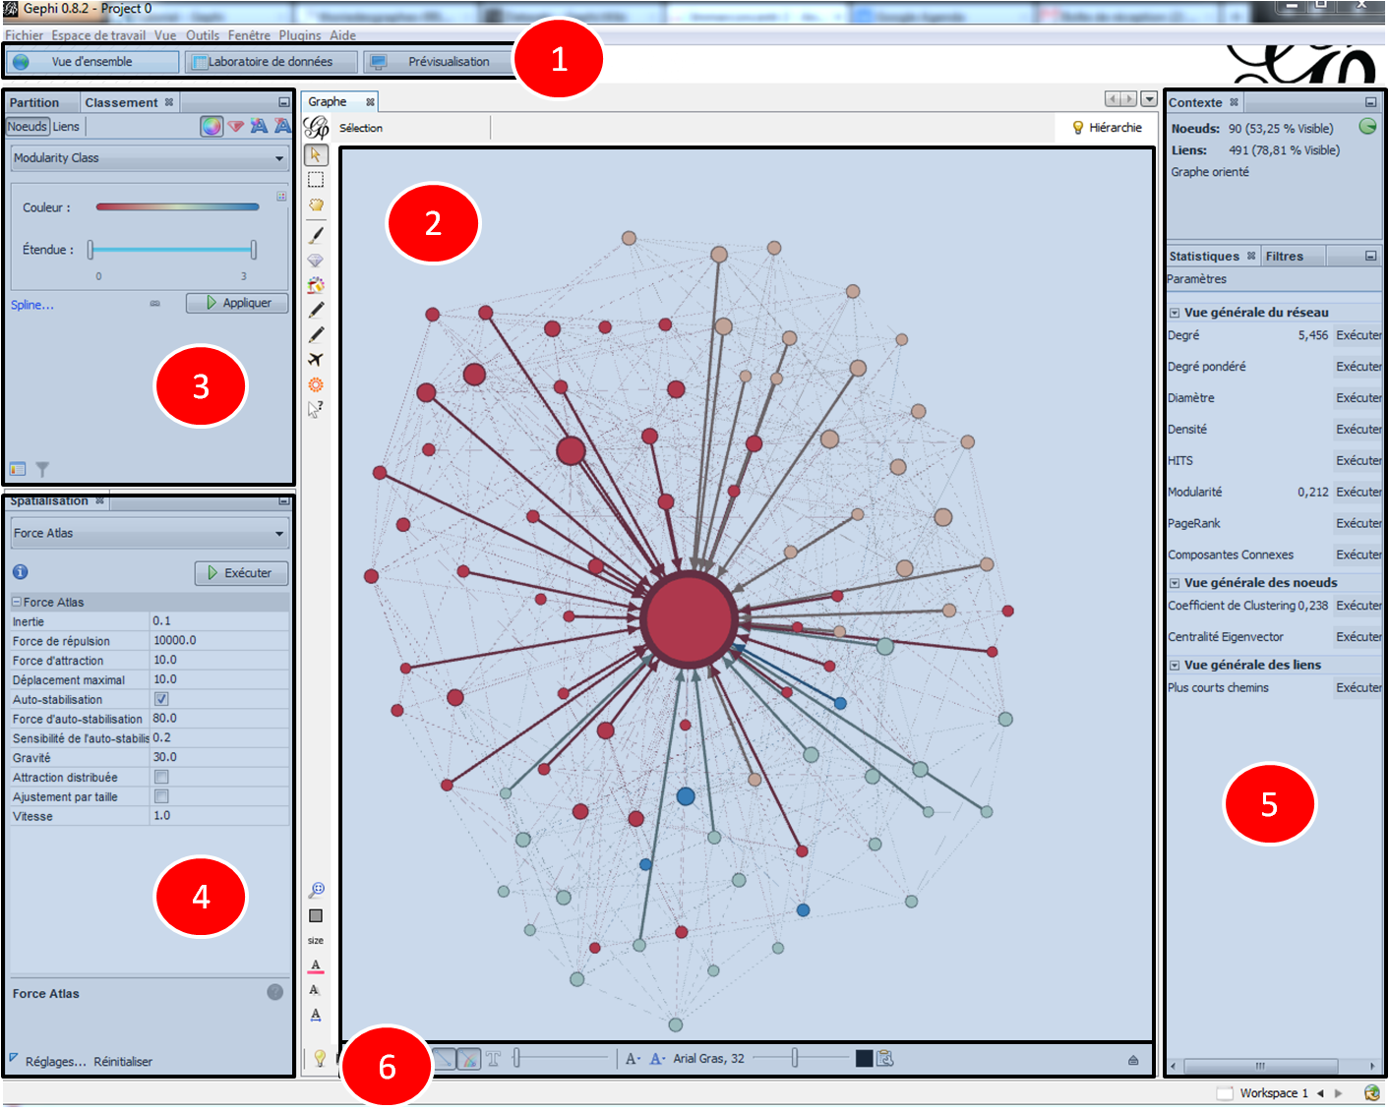
Gephi interface

Slide 9
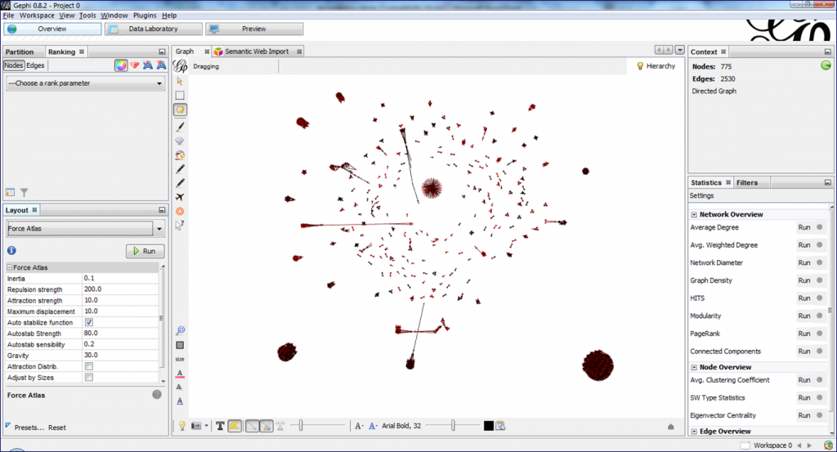
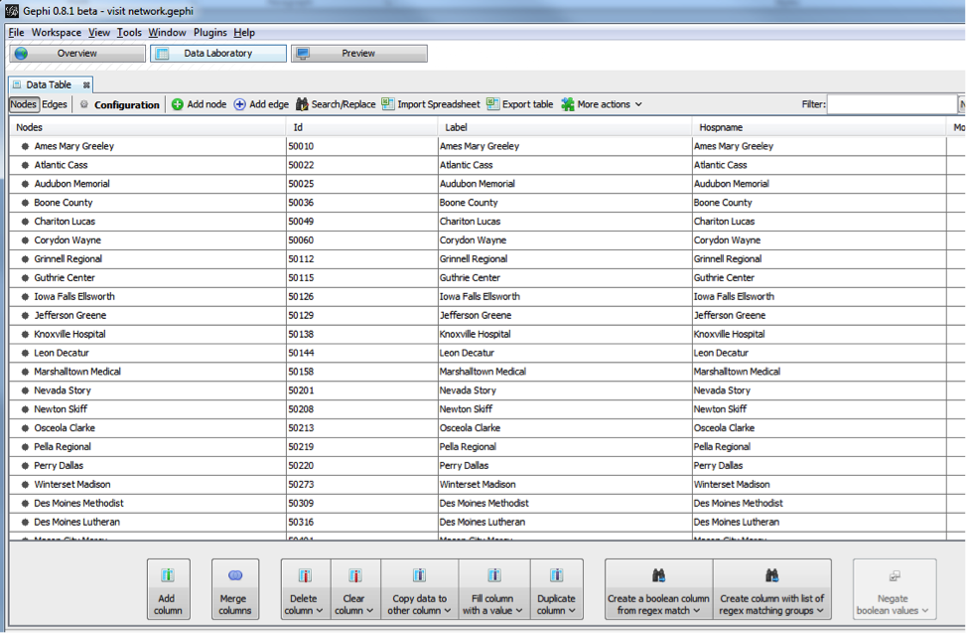
1) The change of view or taskbar: This is an area to move from one tab to another.
Overview to analyze information: gives access to general software features and work in real time. (access points 2, 3, 4, 5, 6)
Data Laboratory to access de data manipuled as in excel: Allows to see or modified if necessary some parameters to the needs of the users.

Slide 10
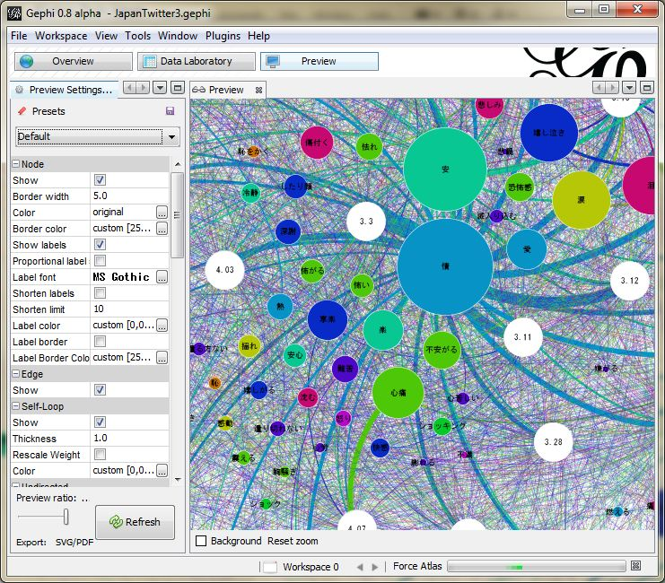
2) The central area: It allows you to view a real-time overview of the current job or work done. 3) The area classification and partition: To color data based on parameters obtained by statistical analysis, or separate data to apply different colors.
Preview to get a final result: allows to fine-tune the visualization and generate a beautiful image

Slide 11
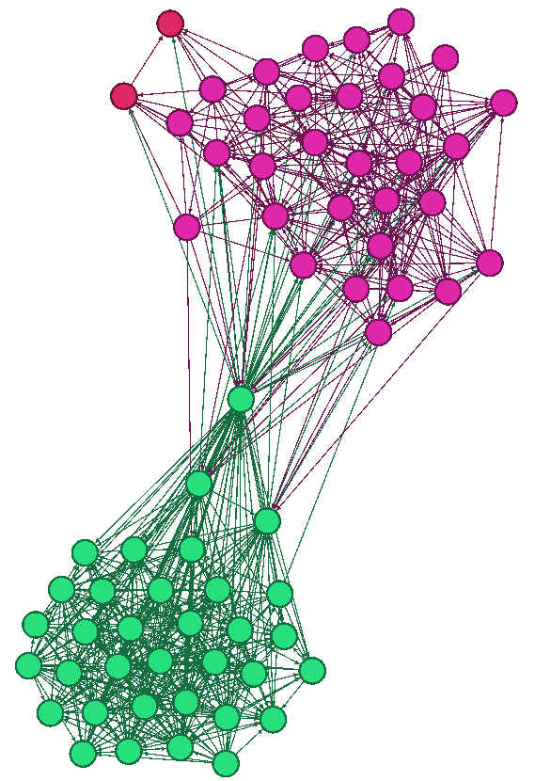
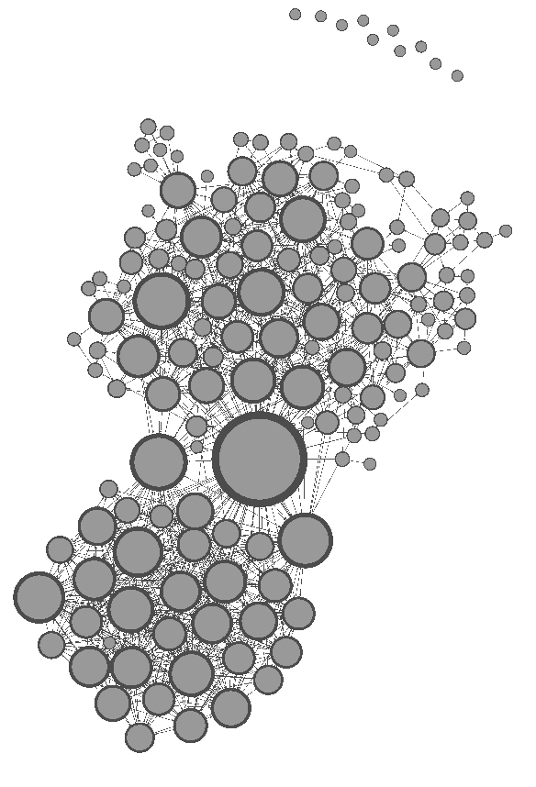
The coloring of nodes according to some statistical parameters
coloring of nodes based on different communities involved in a group of my facebook network.
Changing the size of the nodes based on some statistical parameters
changing the size of the nodes according to the degrees

Slide 12
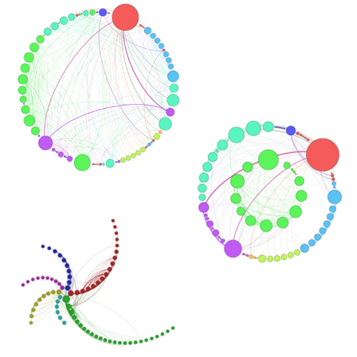
4) spatial zone: Zone where chooses the necessary algorithms (plugins) to better view the information. Concretely there are 4 types of algorithms as needed:
Ranking algorithms
Circular layout
Radial Axis layout

Slide 13
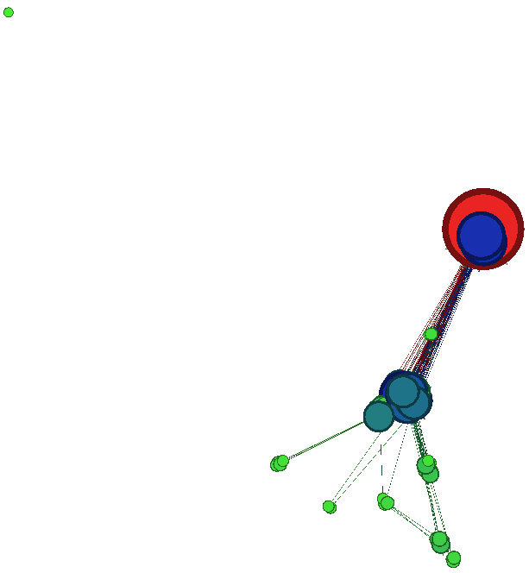
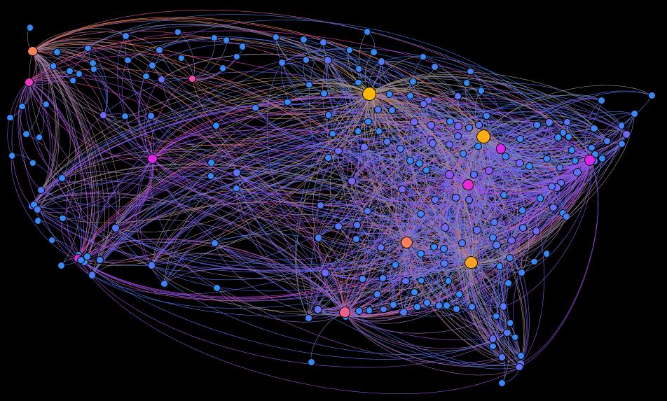
Algorithms divisions
OpenOrd
Algorithms geographic distributions
GeoLayout

Slide 14
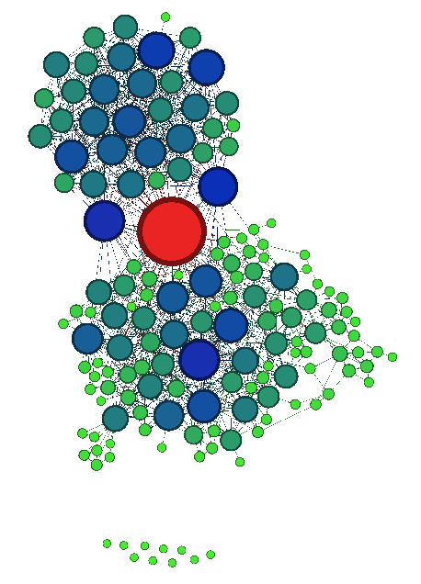
Complementarities algorithms
Force Atlas
Force Atlas 2
Force Atlas 3D
Yifan Hu
Frushterman
…..
We also have:
• Adjustment of labels / noverlap: Avoid the names overlap on your network
• Contraction / expansion: Increases or decreases the space between the nodes

Slide 15
5) Filter tab and statistic
With this tool, we can remove some nodes of our network, filter information based on certain parameters, but also perform statistical analyzes.
Statistics tab
The parameters that we can have are:
Degree: calculate the number of links has a node
Degree weighted: calculates the average number of links can have a node.
(They refer Degree Distribution, In-Degree Distribution, Out-Degree Distribution)
Diameter : is the longest distance between two network nodes.
It returns:
Betweenness centrality: which measures the frequency of occurrence of a node on the shortest paths between network nodes
Closeness centrality: measures the average distance between a node and all other nodes.
Eccentricity: measuring the distance of a node relative to the most distant node from it.

Slide 16
Density : determines the percentage of network complementarity. Modularity : identifying groupings to highlight the communities in a network Eigenvector centrality: measures the importance of a node in the network according to its connections Related Components: determines the number of connected components in the network HITS Page Rank related components: determine the number of connected components in the network.

Slide 17
Filter The data can be filtered according to several domains (network attributes, network topology, network operators in the (Union, Intersection, ...), the dynamics of the network, the network links or even already saved queries ). These attributes using all statistical parameters seen above.
6) The data display
This tab allows you to vary the size of the nodes, links between nodes, and display the name of the nodes.
It manages the readability of the network according to the need of the user.

Slide 18
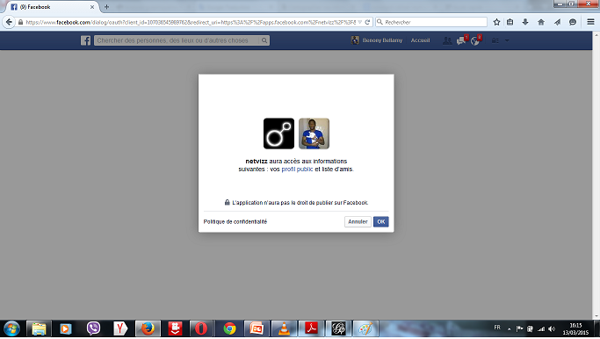
Using Gephi on facebook social network (Practical part)
Import data file
Above all, we must reap our facebook data.
To do this we have several applications on Facebook that allow us to export the data as .gdf files (Netvizz, netvizzpg, myfnetwork ...).
In this demonstration, we will use the Netvizz application that can allow us to import data types: group data, page like network, data page
Open facebook account you want to download information.
Enter the name of the application (Netvizz) in the search bar and run.
Validate permissions by clicking "OK”

Slide 19
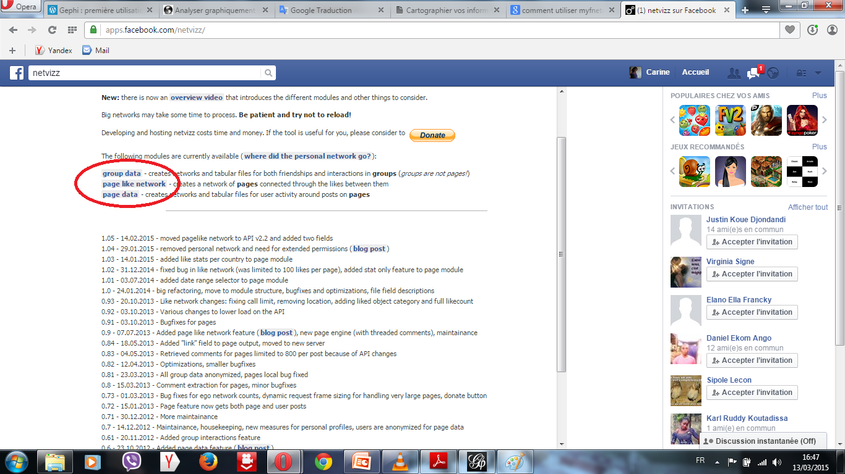
It is located on the facing page against
Then click on the link for the types of information you want to download

Slide 20
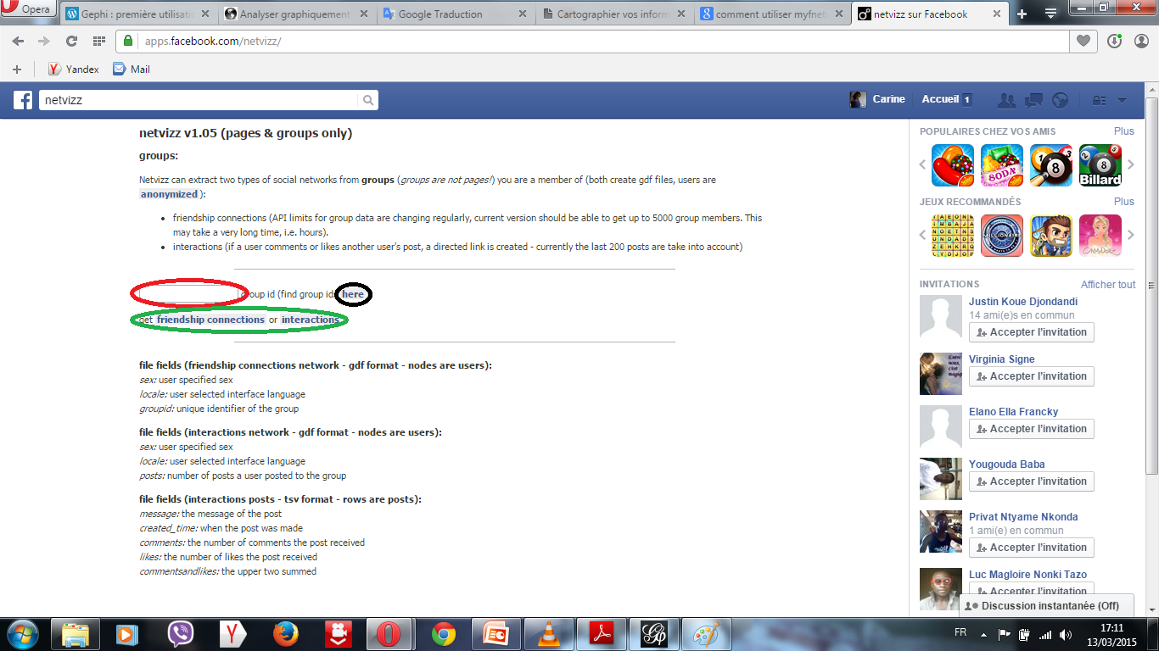
Click on the group data link, which leads to this page.
Enter the id of the group you want information.
Confirm by clicking the link friendship connections or
interactions.

Slide 21
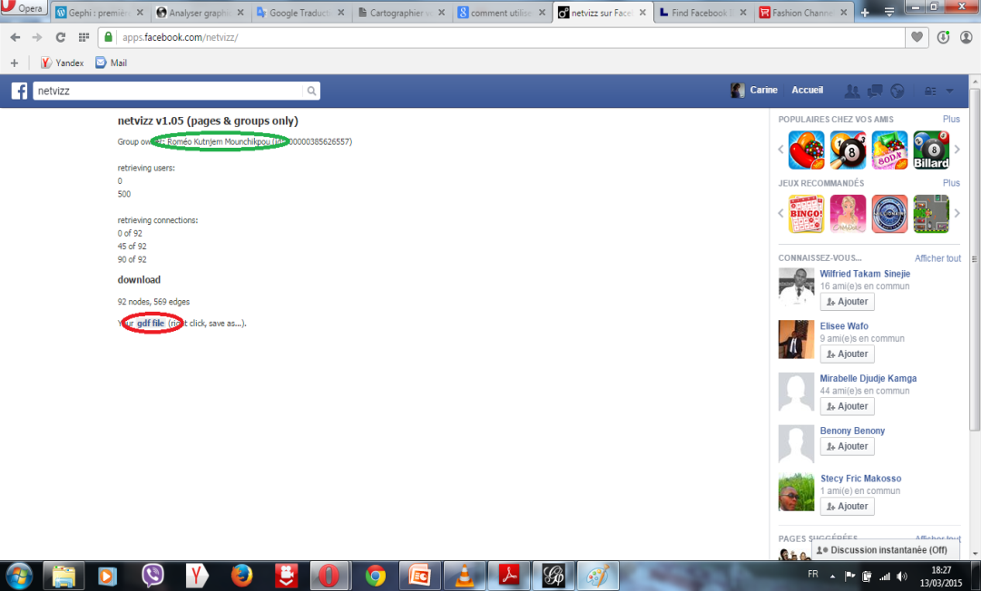
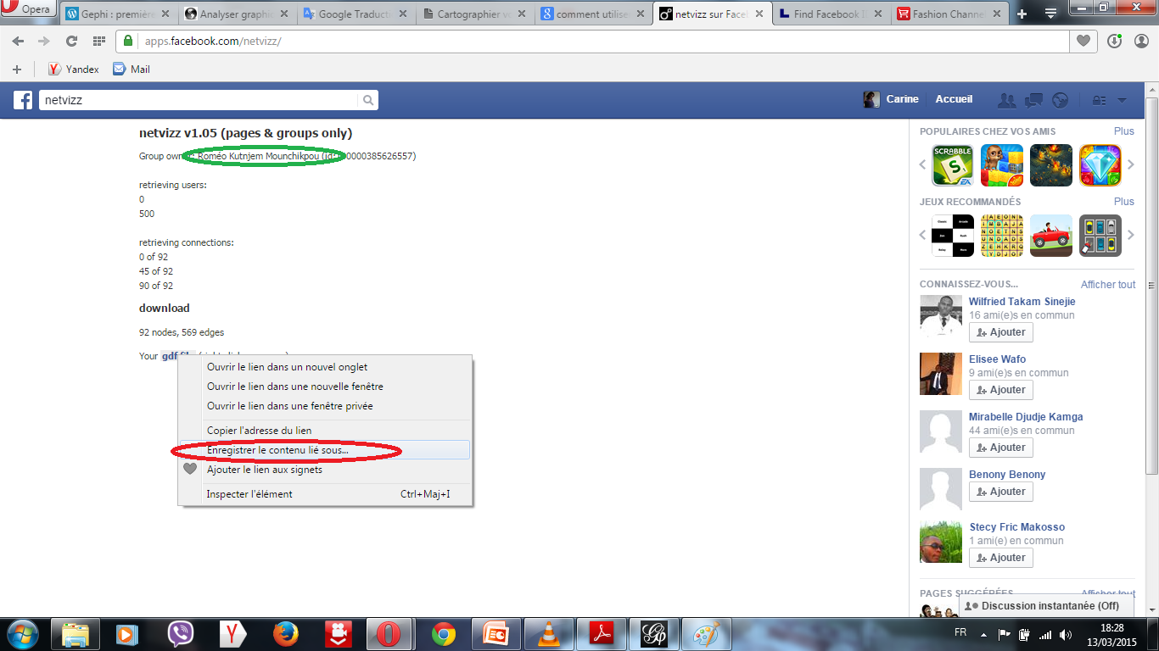
A loading page open, and depending on the number of people that can hold the group, it may take time to download the data.
At the end of the download, save .gdf file.

Slide 22
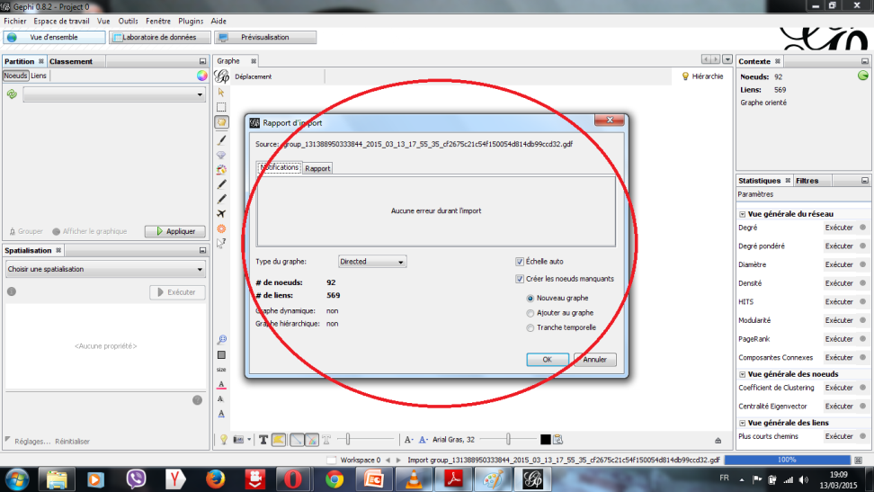
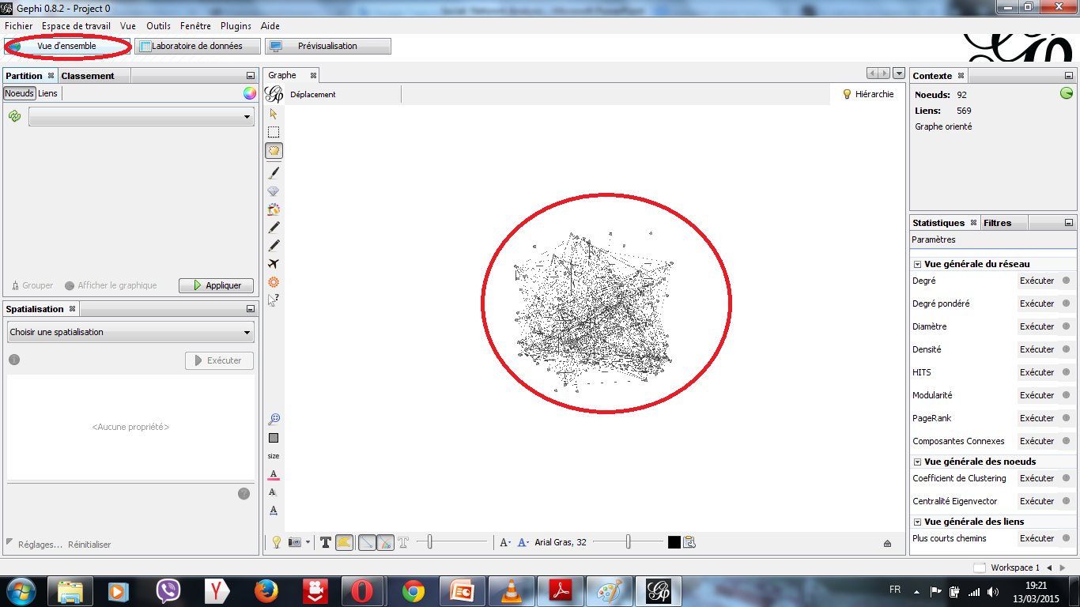
Mapping of data downloaded
Start Gephi
Go to File / New Project
Then File / Open: to open .gdf file download.
Click ‘ok’

Slide 23
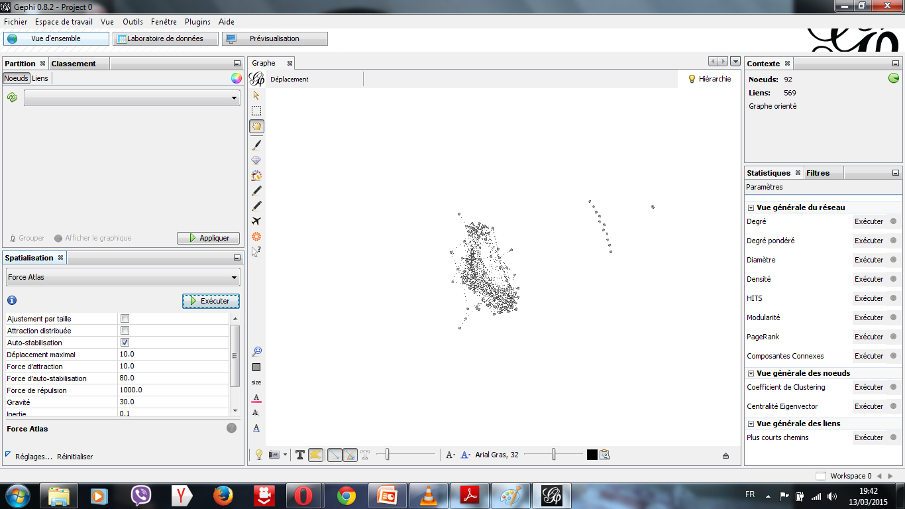
To better glimpse of our network, we will use a first algorithm: Force Atlas best suited for social networks. (If my network is large: Force Atlas 2 is better)
Select Force Atlas in the spatial tab and run. Do not forget to click "stop" when the network seems already stable.

Slide 24
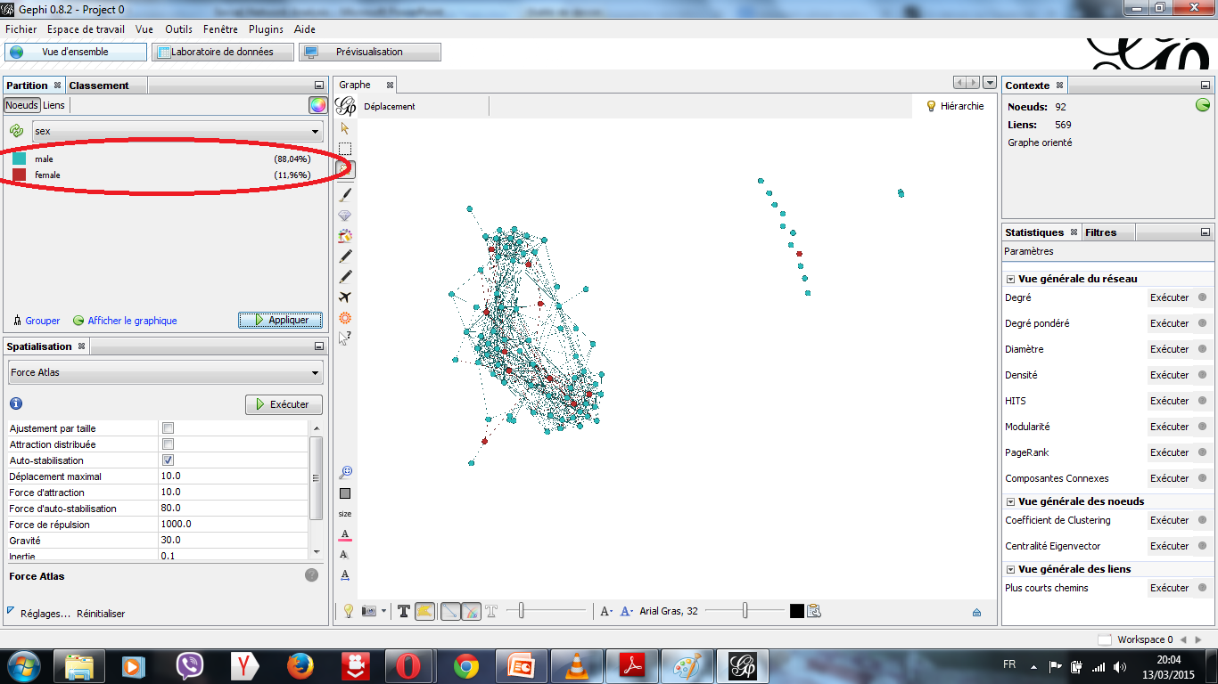
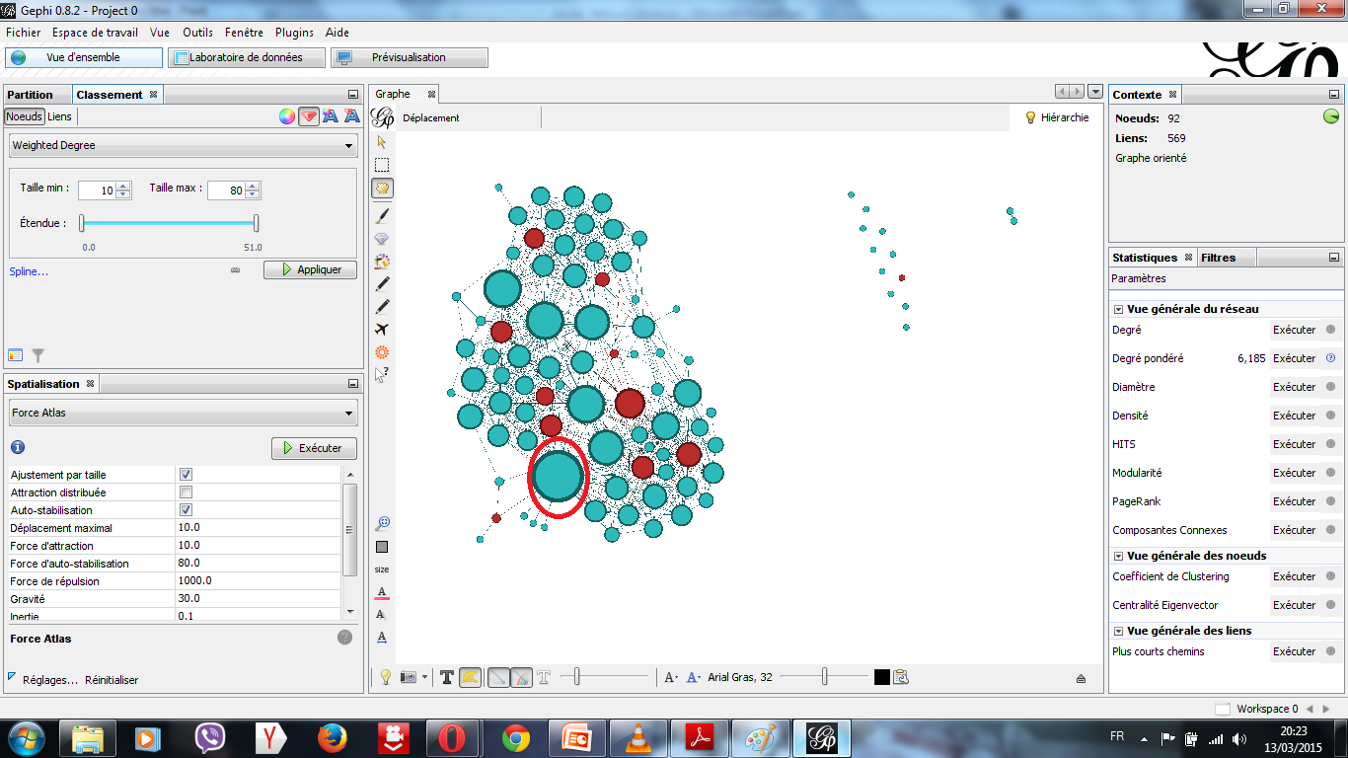
Now we will determine some information in our network:
The gender difference (male and female).
Go to the Partition tab / refresh / choose "sex" / execute.
The individual with the most relationships in the network.
Go to statistics tab and run weighted degree
Go to the ranking tab / select the size symbol / selects weighted degree / runs
Go to the spatial tab / select Force Atlas / check parameter "fit by size" and runs

Slide 25
Group network mapping with Gephi, analysis graphs and interpretation of the results obtained: Name of group: Computer After extractions information about the group by Netvizz, we have the Social Network, which size is the following: Nodes: 155 and Edges: 932 During the analysis of data obtained by Gephi (type of graph: directed) we obtained the following main graphs (figure 1-6):

Slide 26
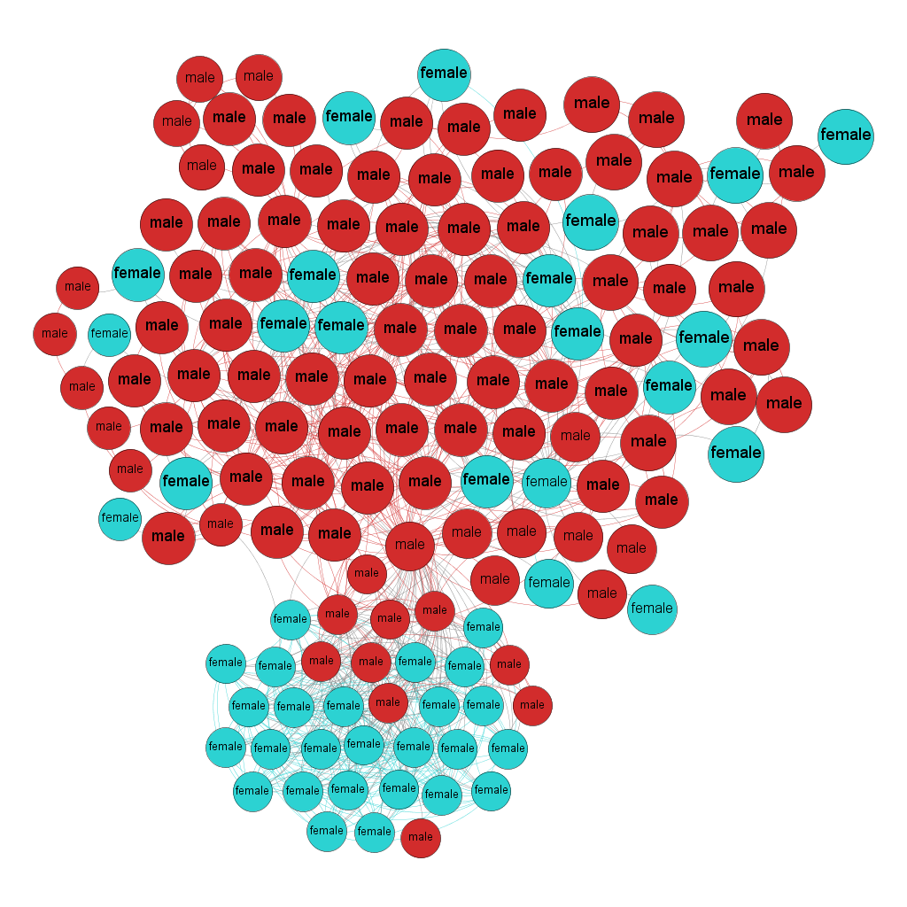
In this first graph the parameters were used: Algorithms Forces Atlas and labels adjustments, Statistical formulas modularity and sex partition
The filter of modularity of order 10(after filter we have: nodes: 145 and edges: 932).
Modularity: 0,463.
Gender partitions: 2 (male = 67.59, female= 32.41)
We use a Gender partition to determinate a percentage of girls in the network.
We can conclude that the analysis of social networks the "Computer" group consists of more boys than girls. And most of these girls are rather strongly connected to each other.
This verifies the fact that, since few girls choose to study computer science, then we will have fewer girls in a group of computer science.
Graph 1
The label in this graph is a Gender of members of group.

Slide 27
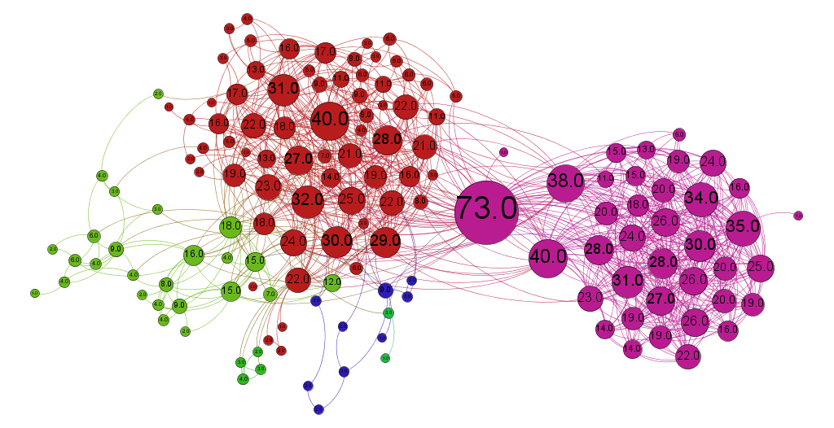
In this second graph the parameters were used: Algorithms Forces Atlas and labels adjustments, Statistical formulas weighted degree and modularity.
The filter of degree of order 1 to remove all individuals who not have more than one connection in the network
Weighted degree: 6,013.
Number of communities: 4
We can conclude that 3 clusters strongly interconnected: cluster of
Computer women arward (Girls of the computer science department who were or are doing in the developments and discoveries in information and communication technologies) (17.36 %);
Informatics developers club: students who share ideas on the development of computer applications (29.75 %);
Google revolution: Students who working and sharing on Google applications (46.28 %).
The individual with the most relationships in this group is the user with degree = 73 relationships (Nodes largest of the graph).This user is a student who created the group “Computer”.
Graph 2
The label in this graph is a degree.

Slide 28
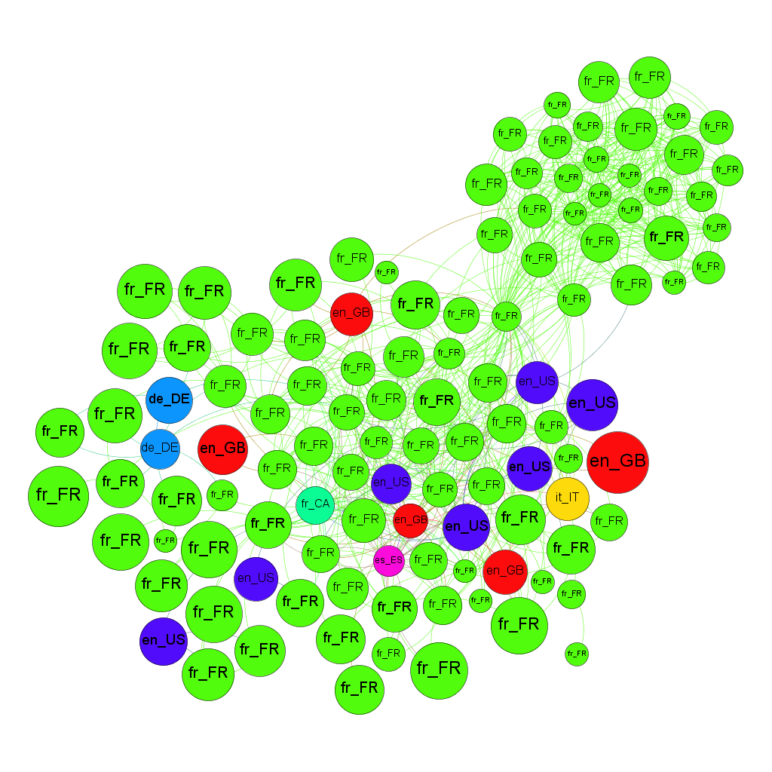
In this third graph, the parameters were used: Algorithms Forces Atlas and labels adjustments, Statistical formulas diameter (closeness centrality) and locale partition.
The filter of closeness centrality of order 0.1 to remove all individuals who have a maximum distance of 0.1 with other individuals and we use a locale partition to know which how many languages is used in this group.
Diameter: 5
Modularity: 0,463
Number of languages: 7
We can conclude that Network students speaking with seven different languages (French of France = 85, 22%, English of USA = 6, 09%, English of England = 4, 35%, German of Germany = 1, 74%, Spanish of Spain = 0, 87%, French of Canada = 0,87% and Italian of Italy = 0,87% ).
Graph 3
The label in this graph is a language of members of group.

Slide 29
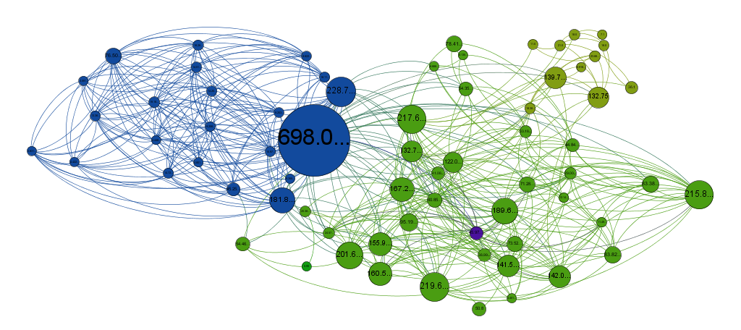
In this fourth graph, the parameters were used: Algorithms Forces Atlas and labels adjustments, Statistical formulas diameter (betweenness centrality) and modularity
The filter of betweenness centrality of order 3.5 to remove all individuals that the percentage of appearance in the shortest path between two individuals is 3.5 maximum
Diameter: 5
Betweenness centrality min: 0.0
Betweenness centrality max: 698.0
Modularity: 0,463
Number of communities: 3
The individual with the highest frequency of occurrence of the shortest paths between two individuals keep is the user with betweenness centrality = 698.0 . This user is a student who created the group “Computer”.
Graph 4
The label in this graph is a Betweenness centrality of members of group.

Slide 30
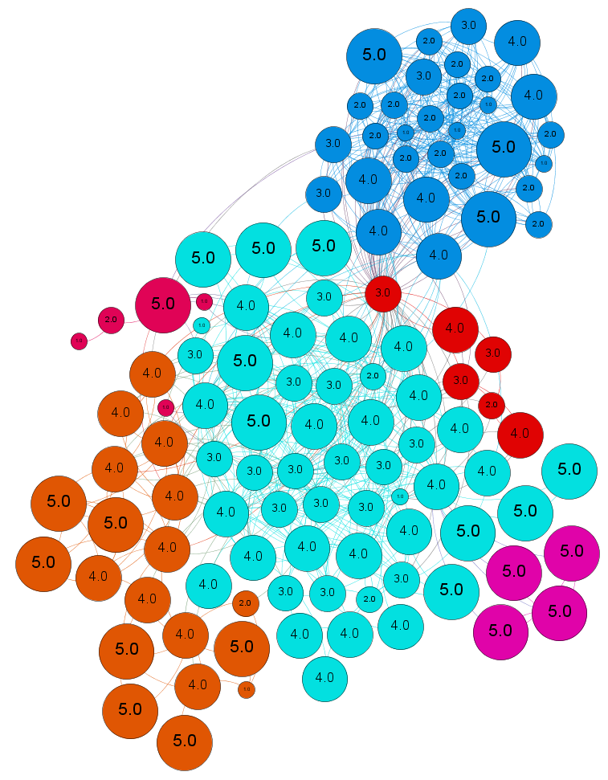
In this fifth graph, the parameters were used: Algorithms Forces Atlas and labels adjustments, Statistical formulas diameter (eccentricity) and modularity
The filter of eccentricity of order 0.51 to remove all individuals who have a maximum distance of 0.51 with the most distant individuals.
Diameter: 5
Eccentricity min : 0.0
Eccentricity max: 5.0
Modularity: 0,463
Number of communities: 6
In this graph, over the node is bigger, the individual is away from the other members of network.
Graph 5
The label in this graph is a Eccentricity of members of group.

Slide 31
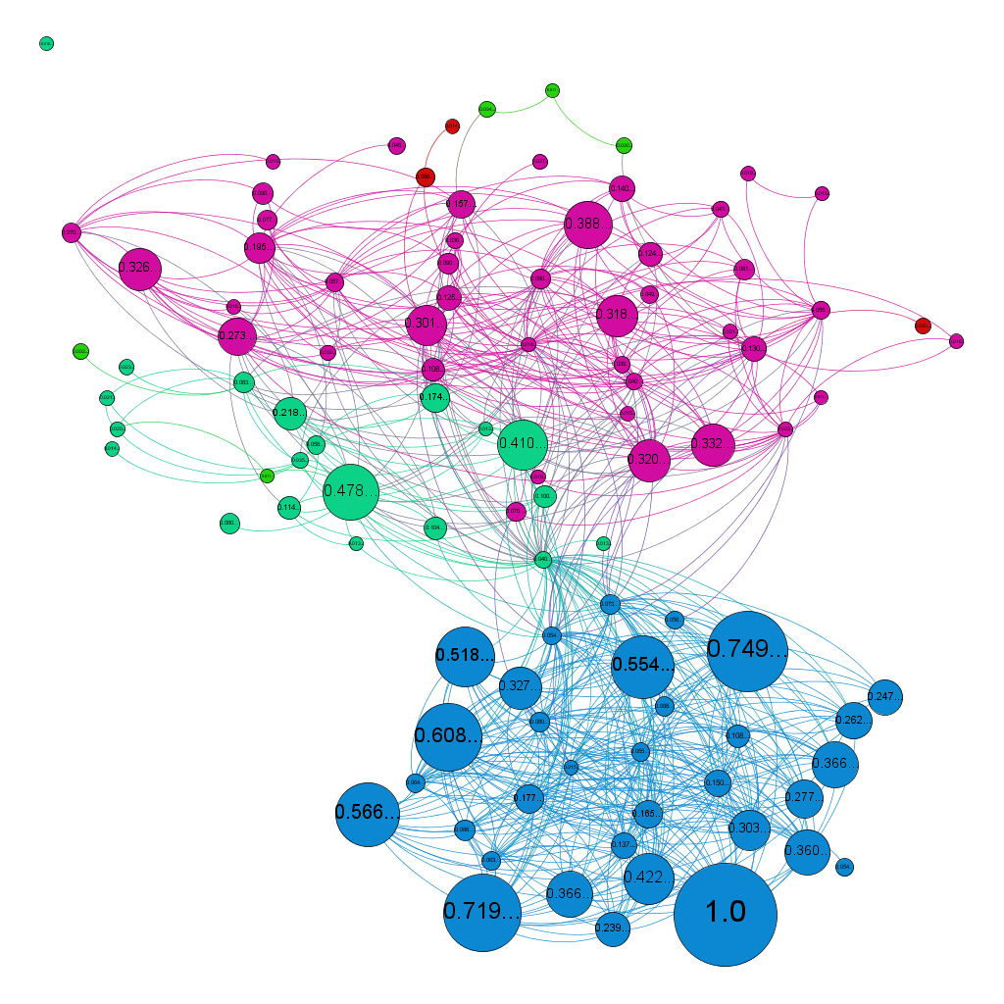
In this sixth graph, the parameters were used: Algorithms Forces Atlas and labels adjustments, Statistical formulas Eigenvector centrality and modularity
The filter of Eigenvector centrality of order 0.01 to remove all individuals who have an importance of 1% in the network.
Number of iterations: 100
Eigenvector centrality min: 0.0
Eigenvector centrality max: 1.0
Modularity: 0,463
Number of communities: 4
The individual with the most importance in the network is user with Eigenvector centrality = 1
Graph 6
The label in this graph is a Eigenvector centrality of members of group.

Slide 32
The SNA is a useful and effective instrument for revealing the main specificity of the human's relationships of the social groups;
Software Gephi is the applicable tool for visualizing revealed people's interactions peculiarities and the relational dimension of the communities inside the social groups.

Slide 33
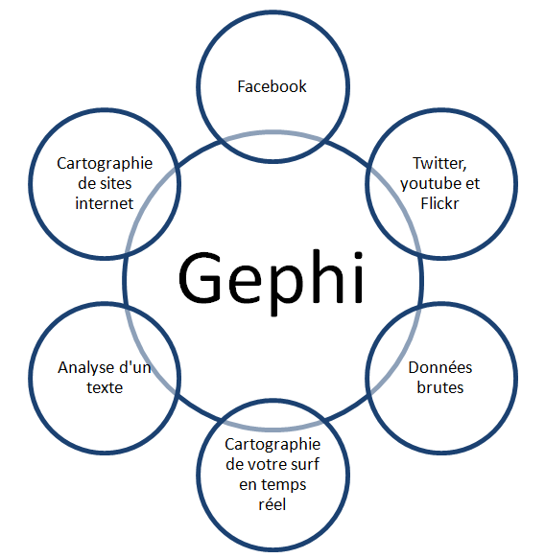
Where we can also use Gephi
Apart from the analysis of social networks (facebook, twitter, youtube, ...) , Gephi is an application that can also be used for other purposes, with many other types of data:
Raw data,
Mapping a network,
Analysis of a text,
Mapping a real-time surfing,
……
It is also used in several areas of life (biological analysis, geographic analysis, business analysis, pedigree analysis, ...)

